Slide 1
Understanding Age-related Macular Degeneration (AMD) And how you can play a role in protecting your vision
AMD
Speaker Name

Slide 2
FDA Indication for Use
The ForeseeHome is intended for use in the detection and characterization of central and paracentral metamorphopsia (visual distortion) in patients with age-related macular degeneration, as an aid in monitoring progression of disease factors causing metamorphopsia including but not limited to choroidal neovascularization (CNV). It is intended to be used at home for patients with stable fixation.
The ForeseeHome AMD Monitoring Program is prescription use only and is intended to be used in addition to regular eye exams.
The technical component of the ForeseeHome AMD Monitoring Program is covered by Medicare, subject to its coverage requirements for the test, to assess patients with dry AMD who are at risk of developing wet AMD. Please refer to your local Medicare Administrative Contractor (MAC) for which the ordering physician resides concerning coverage availability for the physician professional services component of the test.

Slide 3
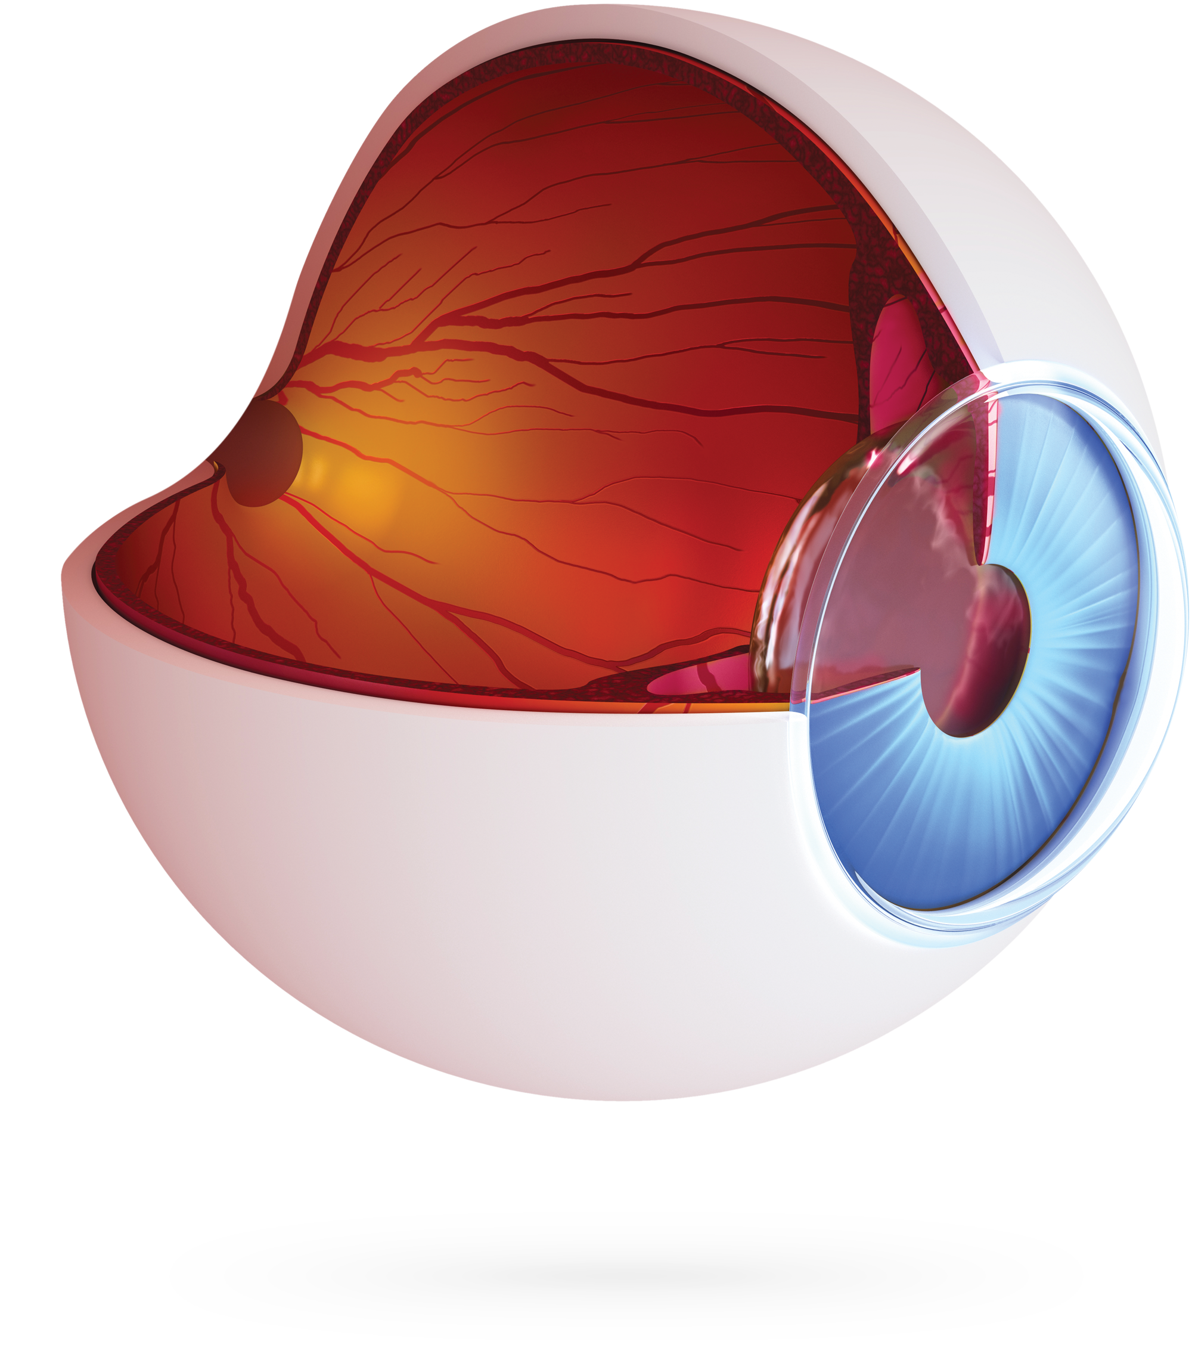
Two types of AMD: dry and wet
Notes:
AMD is the most common cause of blindness in the United States.
Here’s the information you need to get informed and take charge of your vision.
There are two types of AMD: dry and wet

Slide 4
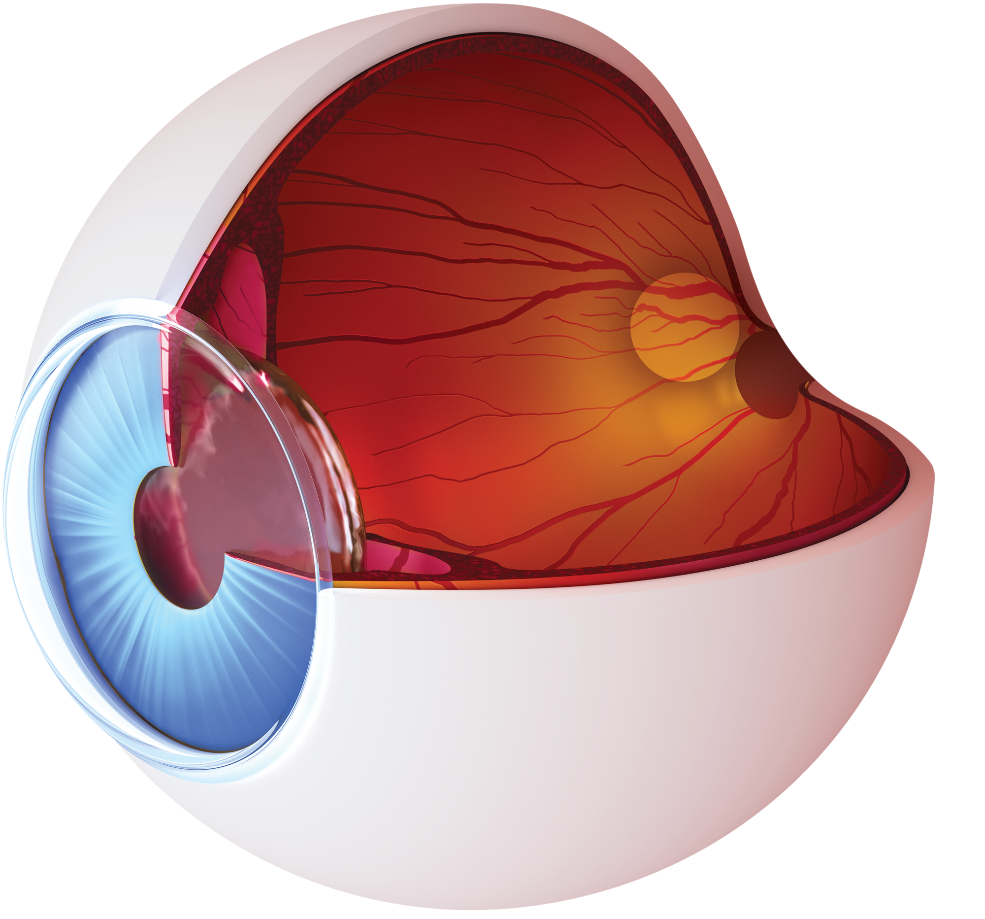
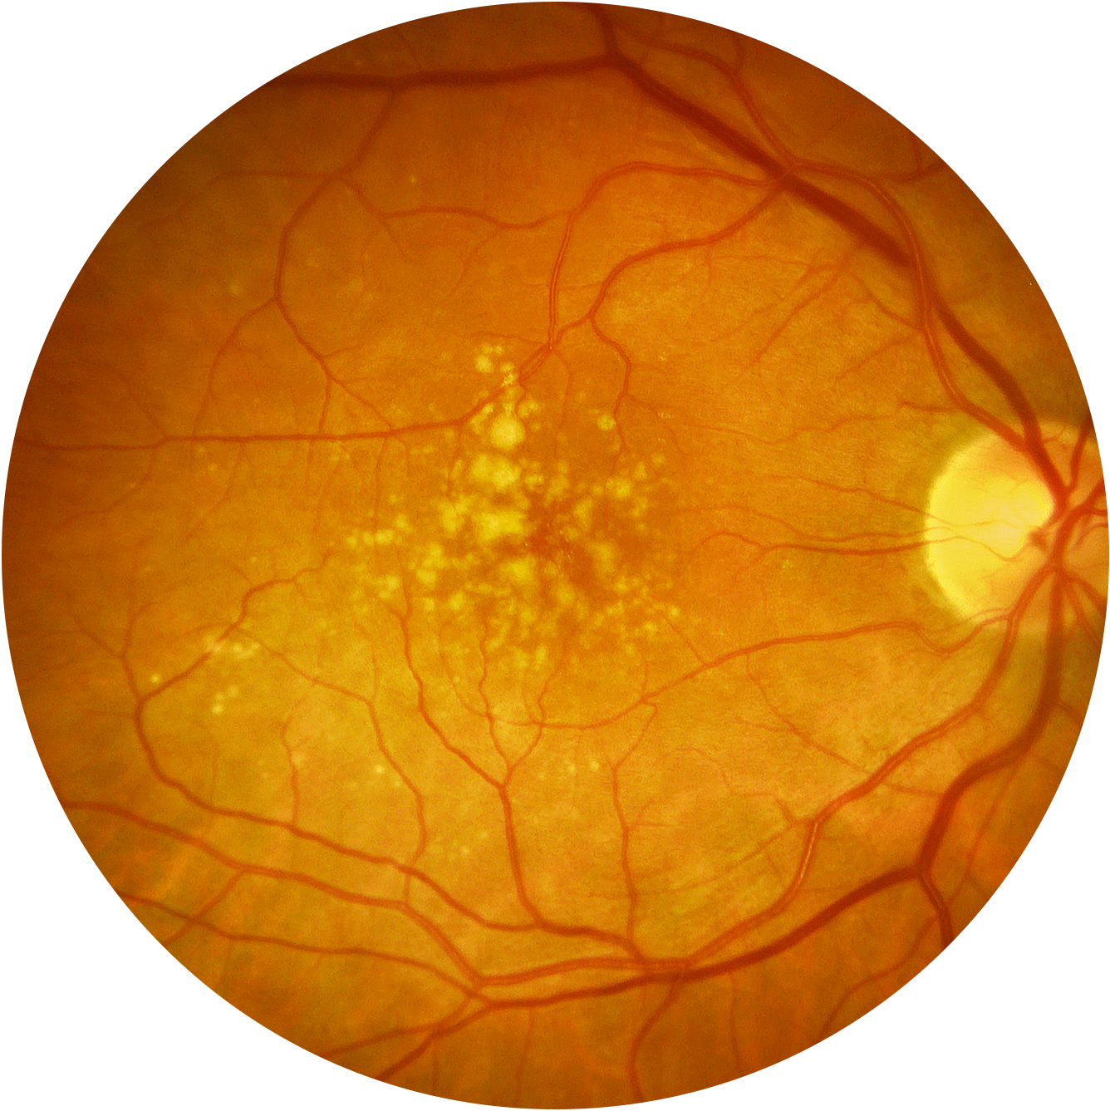
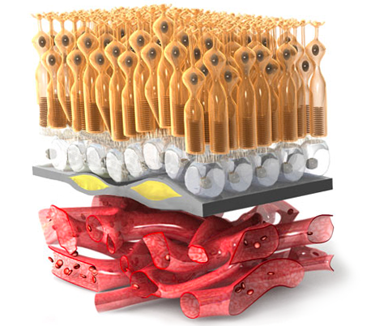
What is dry AMD?
2
Over time, small fatty deposits begin to form called Drusen
1
Dry AMD affects the Macula, responsible for detailed central vision
Macula
Notes:
Dry AMD affects an area of the eye called the Macula, which is responsible for detailed central vision used for activities like reading, driving, and seeing faces clearly
In dry AMD, changes occur in the cells of the macula. Drusen build up in this area.
These changes may include blurry vision, such as difficulty seeing sharp details, both up close and from a distance
Dry AMD is the slow form of the disease, with changes you may not notice over time. Most importantly, dry AMD puts you at an increased risk of progressing to the wet AMD

Slide 5
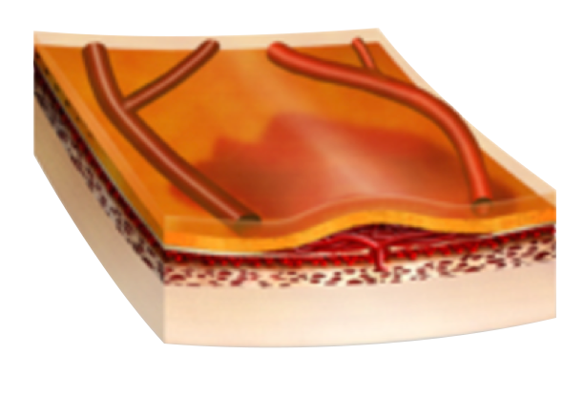
As the size and number of these deposits increase, so does your risk of developing wet AMD
Dry AMD can suddenly change to wet AMD without advance notice
You may not notice changes until significant vision loss has occurred
Notes:
Over time, the size and number of these deposits can increase, which increases your risk of developing the more sight-threatening form, wet AMD
Dry AMD can suddenly change to wet AMD without advance notice.
If you convert to wet AMD, abnormal blood vessels grow under and into the retina (in the macula). These blood vessels leak fluid and can sometimes bleed without any warning.
You may not notice changes until significant vision loss has occurred.

Slide 6
When wet AMD occurs, significant vision loss can be rapid and severe
*For illustrative purposes only
Notes:
If you convert to wet AMD, significant vision loss can be rapid and severe.
Symptoms of wet AMD include:
Distortion or straight lines that look wavy
Dark spot (or spots) in the center of your vision
Generalized blurry vision

Slide 7
Early detection provides best chance of helping you maintain good vision and your independence
Once wet AMD starts, it will continue to advance until you receive treatment
Irreversible damage can occur within days to weeks and before symptoms are noticed
Once symptoms of visual impairment are noticed, vision loss may have already occurred
You can play a role in protecting your vision through at-home monitoring
Notes:
Unlike dry AMD, there are effective treatments for wet AMD. But these treatments are most effective when administered early on, before symptoms are noticed and vision loss has occurred. These treatments can halt or slow the progression of wet AMD, but cannot restore vision that has already been lost.
How early is early detection?
Once the wet AMD starts, it will continue to advance until you receive treatment
Irreversible damage can occur within days to weeks and before symptoms are noticed
Once symptoms of visual impairment are noticed (wavy lines or dark spots), vision loss may have already occurred
The earlier you catch wet AMD, the better chance you have of preserving your vision and independence.

Slide 8
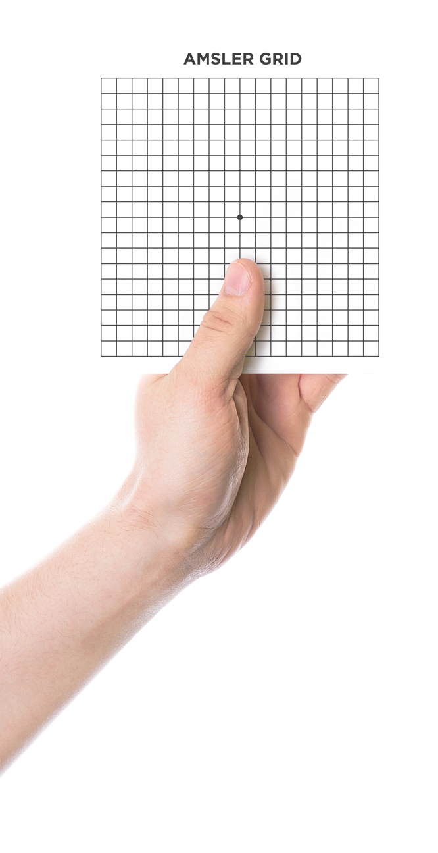
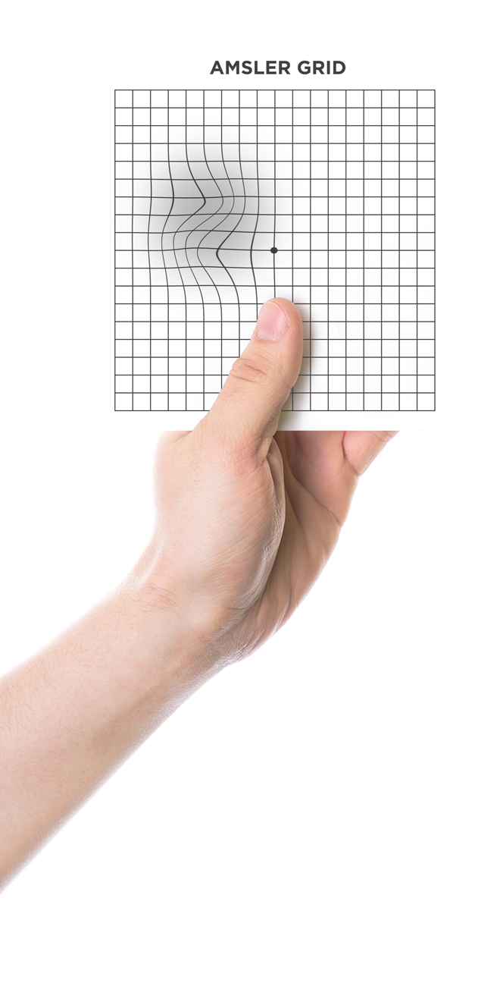
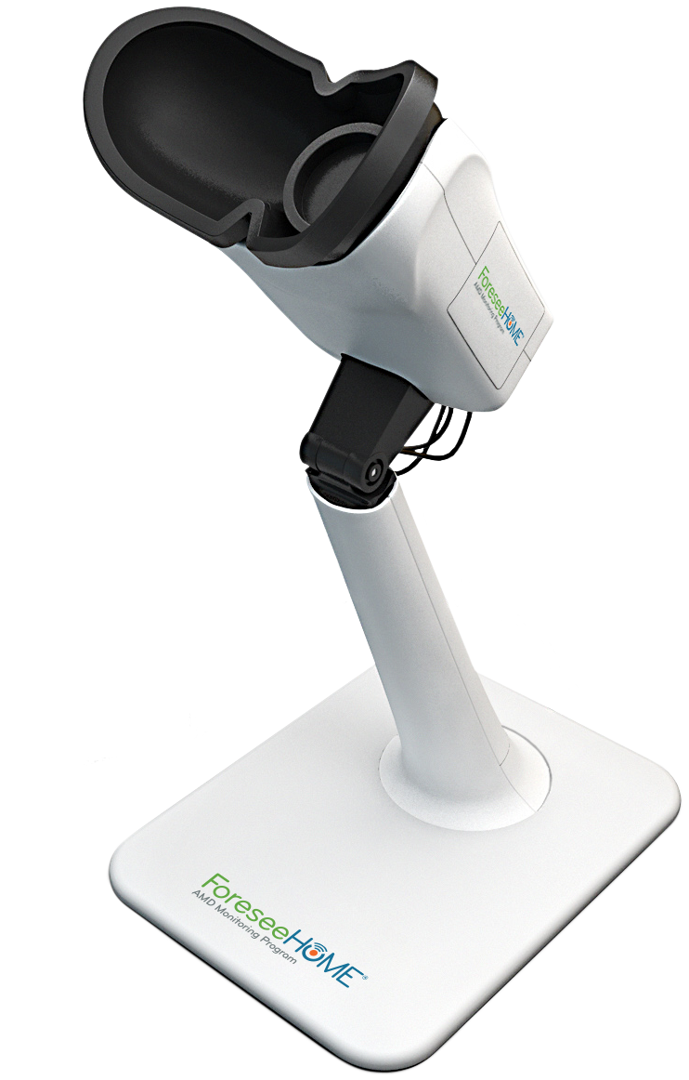
At-home monitoring of wet AMD
FDA Cleared | Medicare Covered
1945
2019
vs
Standard of Care
Distortions you see could mean that vision loss has already occurred
ForeseeHome® AMD Monitoring Program
Easy-to-use home monitoring, which can be sensitive to small distortions
62%
94%
Maintained driving vision
at time of diagnosis
(20/40 or better)¹
including regular eye exams and using the Amsler grid at home
when ForeseeHome was added to regular eye exams and Amsler grid
Notes:
The Amsler grid was developed in the 1940s and has long been recommended as a simple and accessible tool you can use from home to monitor for changes in your vision.
However, by the time you notice vision distortions on the Amsler grid, significant vision loss may have already occurred.
Fortunately, new technology has been developed to detect tiny changes before symptoms are noticed and report them to your doctor so you can receive immediate treatment.
94% of patients using ForeseeHome maintained driving vision (20/40 or better) at wet AMD diagnosis compared with 62% of patients using standard methods of detection alone.
The HOME Study was terminated early due to efficacy¹
¹Chew EY, Clemons TE, Bressler SB, et al; AREDS2-HOME Study Research Group. Randomized trial of a home monitoring system for early detection of choroidal neovascularization home monitoring of the Eye (HOME) study. Ophthalmology. 2014;121(2):535-544.

Slide 9
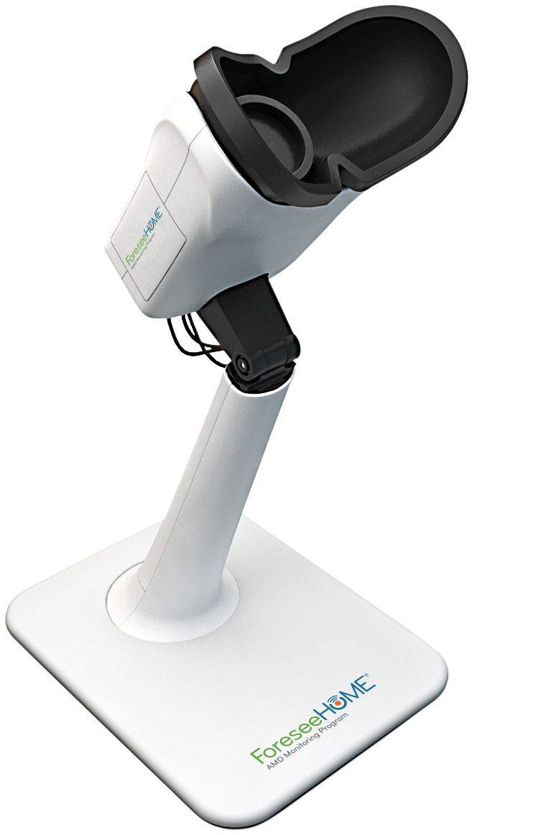
ForeseeHome AMD Monitoring Program An early warning system for eyes
You take an easy, daily test that checks for tiny distortions in your vision. Just a few minutes per day
Data from each test are sent to Notal Vision (the maker of ForeseeHome) for evaluation and then provided to your eye doctor
If a change in test scores is detected, Notal Vision alerts your doctor. Your doctor’s office will then contact you directly to schedule a follow up visit
Notes:
ForeseeHome is a device you use at home. It helps people with dry AMD detect wet AMD before you even notice that visual changes have occurred.
How does it work?
You take a simple, daily test that checks for tiny changes in your vision.
Data from each test are sent to your eye doctor and Notal Vision, the maker of ForeseeHome
If a change in test scores is detected, Notal Vision alerts your doctor. Your doctor’s office will then contact you directly to schedule a follow up visit.

Slide 10
Testing with ForeseeHome is easy
1
2
3
Turn the device on
Turn on the device and look into the viewfinder to begin testing
Take an easy test
A bump will briefly appear and then disappear. Use the mouse provided to click where the bump appeared and return to the center dot
Your results are sent
Data from each test are sent to Notal Vision for evaluation and then provided to the eye doctor
Regular, at-home monitoring is like brushing your teeth—it’s a good, healthy habit you do every day to help preserve vision

Slide 11
Video will auto-play in presentation mode

Slide 12
Little to no out-of-pocket costs for the majority of Medicare patients
FDA Cleared
Medicare Covered
$0
for the majority of Medicare patients
Patients with Medicare and a secondary supplement plan could have out-of-pocket costs as low as $0 per month
$15.03 per month
For patients without supplemental insurance
Patients with Medicare and no secondary supplement plan will pay $15.03 per month once their $185 yearly Medicare Fee-for-Service Part B deductible is met*
*Does not apply to patients enrolled in Medicare Advantage Plans.
Patient Financial Assistance Program is available for qualifying patients

Slide 13
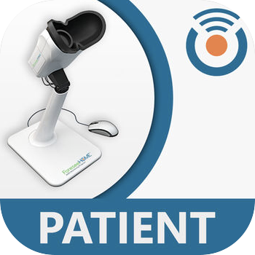
ForeseeHome Online
Patient Portal & App
Or access your dashboard online at
Download the App
www.foreseehomeonline.com

Slide 14
Life isn’t always about preserving your vision… but vision is paramount to keeping your independence
AMD
At-home monitoring is a habit you can do every day, like brushing your teeth, regardless of health priorities
Patients preserved more of their vision when wet AMD was detected using ForeseeHome than waiting for a regular eye exam¹
“
“Testing my eyes on a regular basis gives me a sense of security.”
- ForeseeHome Patient

Slide 15
Take the proactive approach to protecting your vision–get started with ForeseeHome
A ForeseeHome Clinical Partner will be with you for every step of the set-up process
After receiving a prescription, you will receive a call to answer any questions, verify coverage, and ship your device
Once you receive the device, they will walk you through set up and training
You will continue to receive feedback through the ForeseeHome Patient Portal or App
No obligations. The ForeseeHome AMD Monitoring Program can be cancelled at any time.

Slide 16
References
1. Chew EY, Clemons TE, Bressler SB, et al; AREDS2-HOME Study Research Group. Randomized trial of a home monitoring system for early detection of choroidal neovascularization home monitoring of the Eye (HOME) study. Ophthalmology. 2014;121(2):535-544.
ForeseeHome is not appropriate for all patients. If you have difficulty using a mouse or have other issues with your eyes, ForeseeHome may not be right for you. If this is the case, talk to your eye doctor about other at-home monitoring options to protect your vision.
SM-024.01

