Slide 1
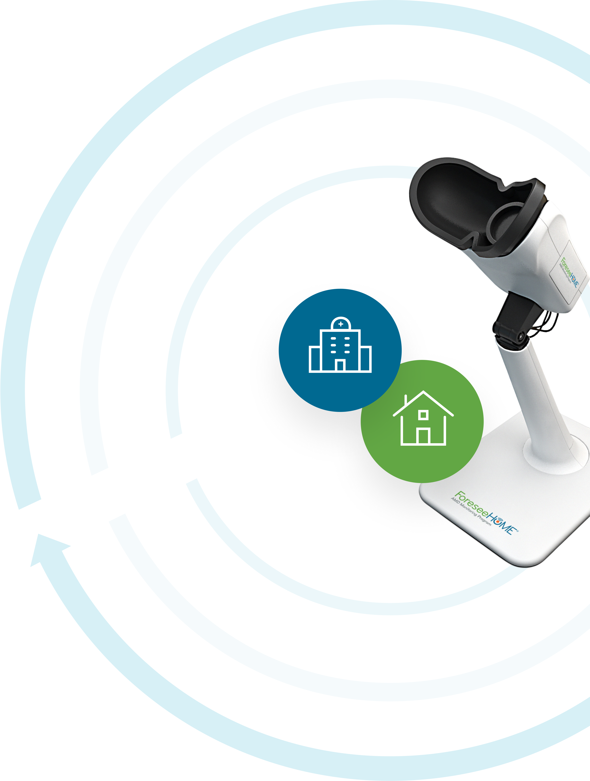
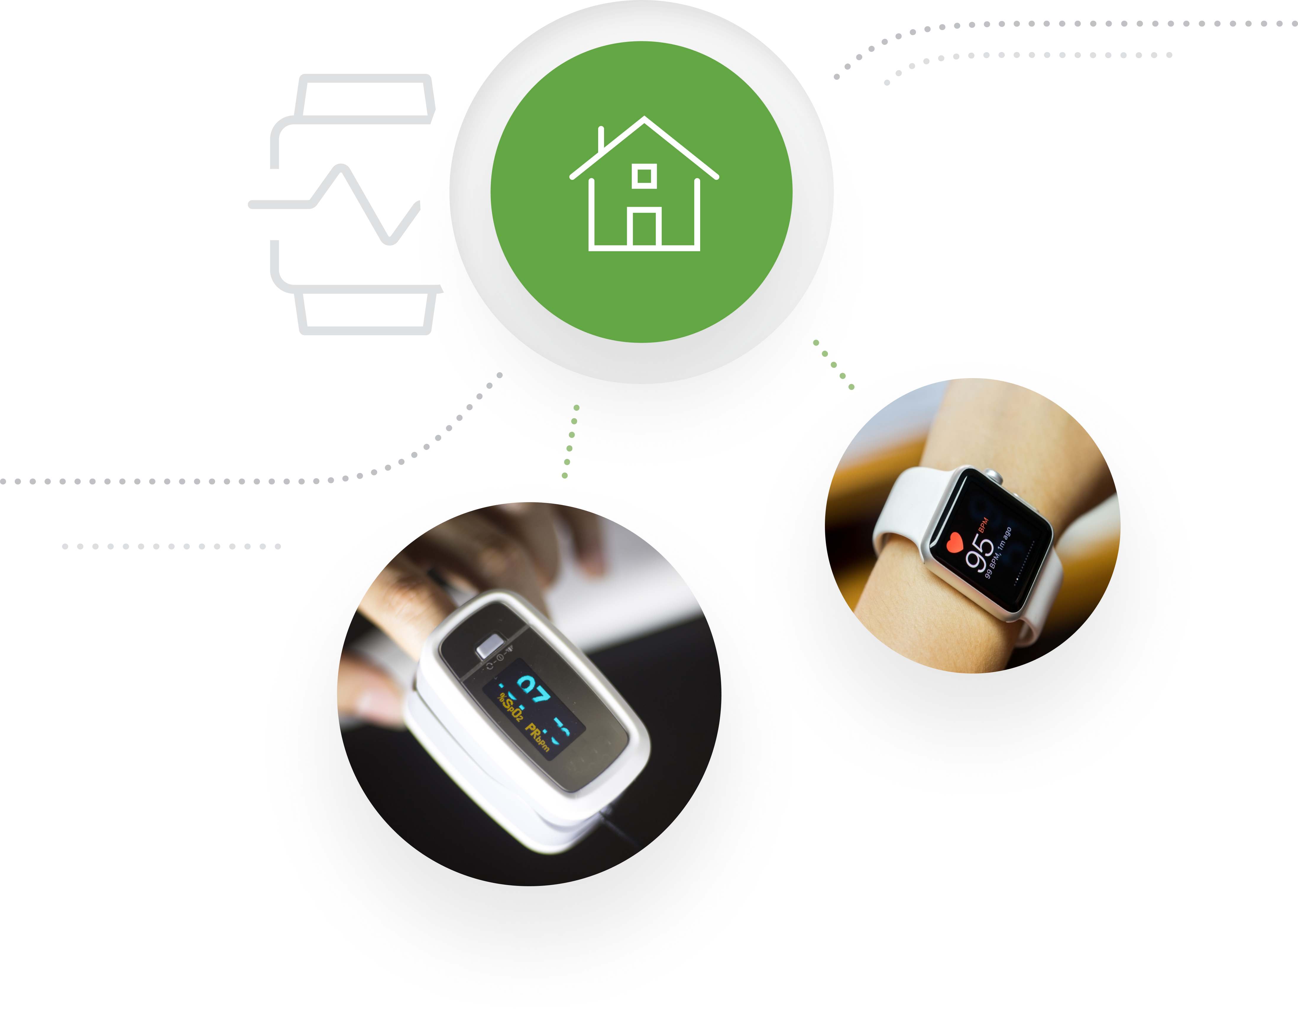
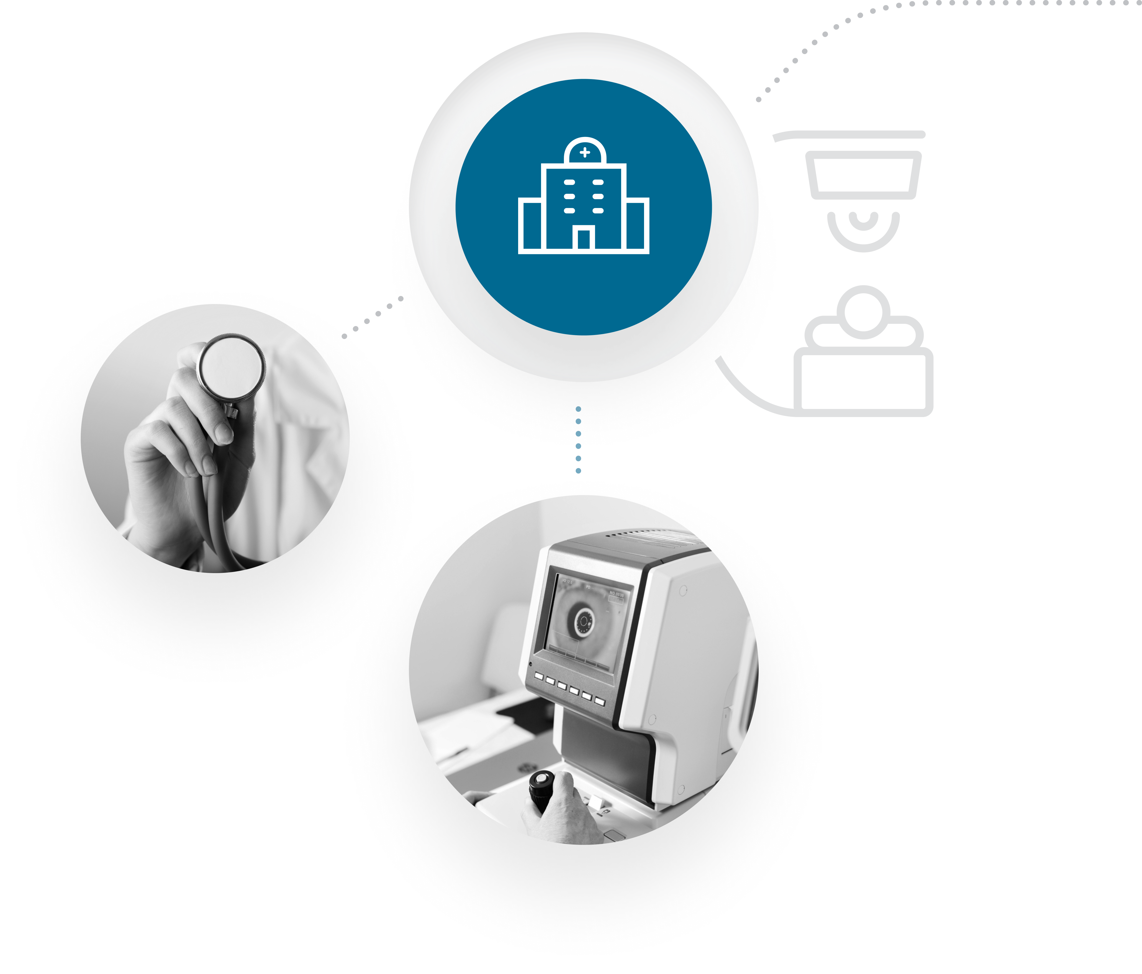
Notal Vision is redefining eyecare with precision medicine
High-frequency, home diagnostic testing to improve vision outcomes and reduce healthcare costs
1
Symptom-Driven Care
Symptom Dependent
Disconnected Patient
Delayed Diagnosis
AI enables high-frequency home monitoring and personalized care, extending disease management
2
Digital Diagnostics
Extended Reach
Still Symptom Dependent
3
Precision Medicine
Producing better outcomes through connected and personalized care
1 | The Evolution of Home Diagnostics
SM-014.02
Notes:
Key Message: Notal Vision is redefining eyecare with precision medicine.
Challenger Sales Talk Track:
Warmer: Breakthroughs in therapeutics and diagnostics can dramatically affect patient outcome but they can also be very challenging to incorporate clinically if not managed properly
Reframe: Remember anti-VEGFs? Many saw the value of adjusting and adopting early while others took a “wait and see approach” and had to play catch up later.
Rationale Drowning:
Those that were proactive went to the referral community, to the patients, saying they are offering the best, most advanced treatment
Those that waited to see what happens were left at a competitive disadvantage
Emotional Impact: Adopting Breakthroughs are complicated, involve risk, but can be the source of competitive advantage
A New Way: Predictive Medicine leveraging Artificial Intelligence (AI) and home diagnostics is the next breakthrough
AAO
Other supporting facts
Our Solution: In Ophthalmology, ForeseeHome is the breakthrough…
Starts with ForeseeHome but more products will be coming from our pipeline and other companies
With FSH, you have the opportunity to take the lead in the community. Offer your referral base and patients the latest technology to improve outcomes
<Discuss Highlights from Elevating the Clinical Benefit>
Set up next steps….

