Slide 1
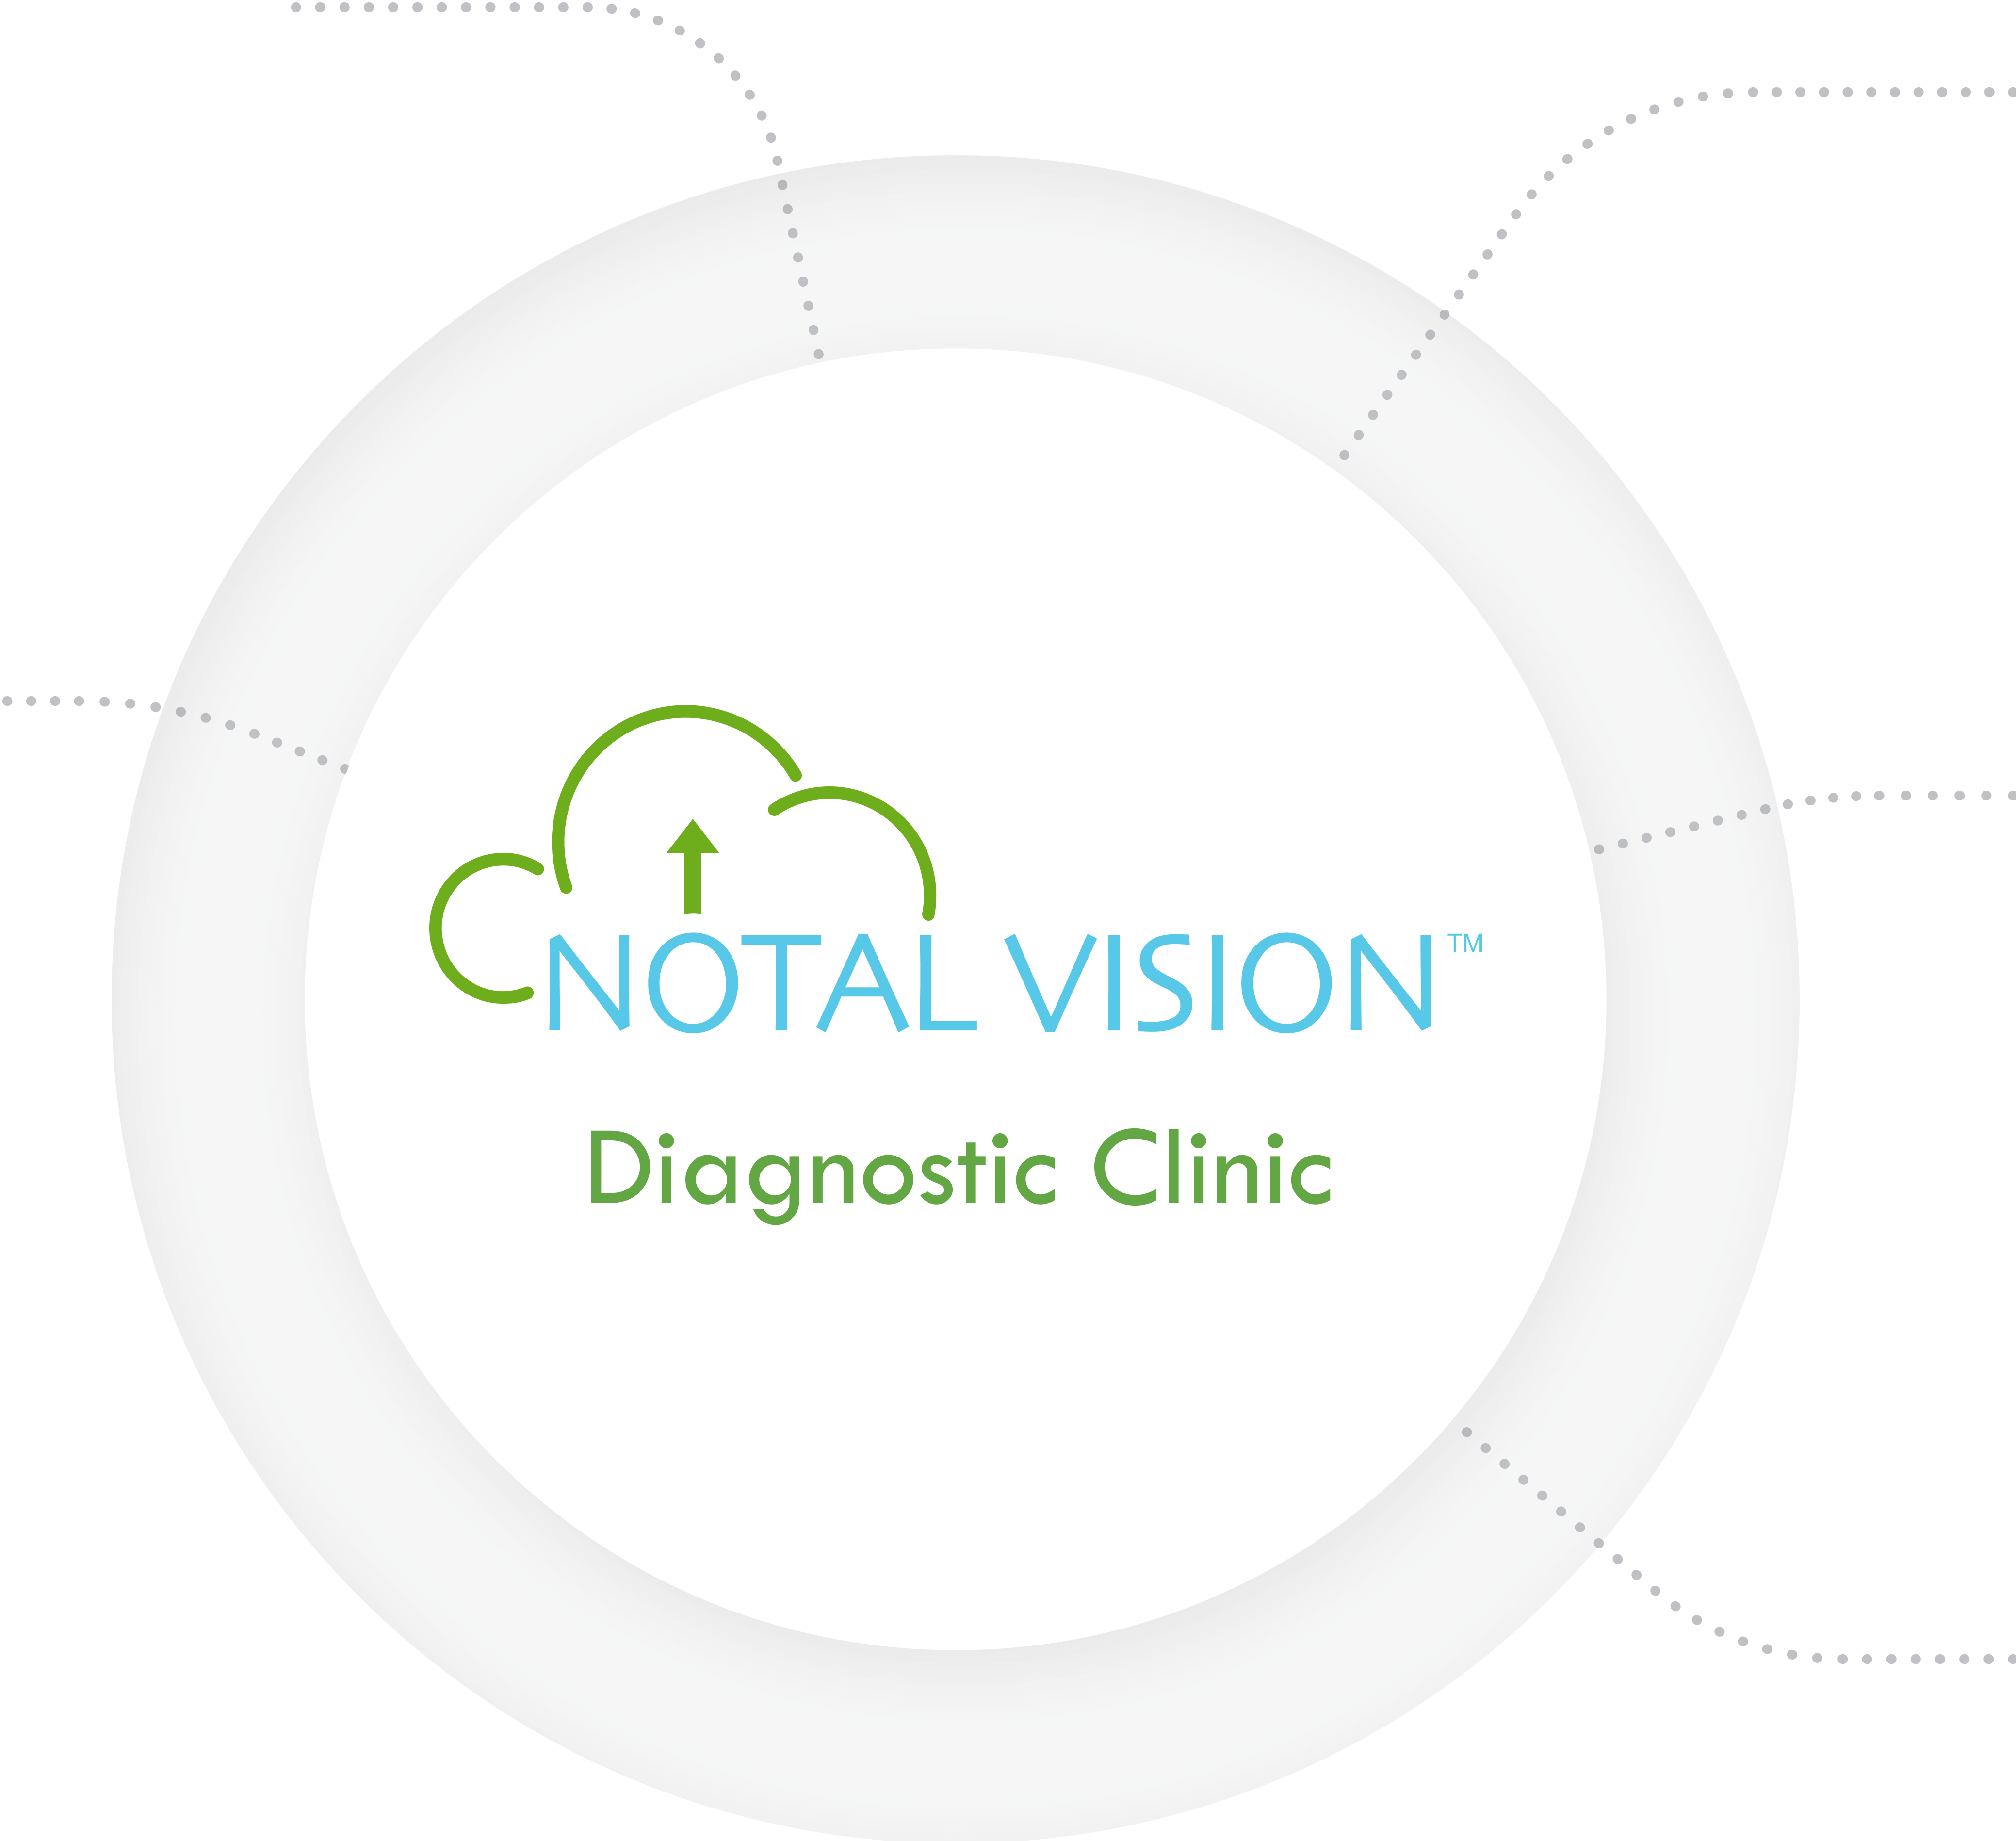
Notal Vision offers a full-service diagnostic clinic providing end-to-end support for your ForeseeHome™ patients
ForeseeHome Clinical Partners
AMD patient education
ForeseeHome training
Medical Management
Clinical data monitoring services
Alert management support
Patient Financial Services
Benefit eligibility and verification
Prior authorization support
Billing inquiry assistance
Patient Engagement
Clinical partner scheduling
User support
Portal/app orientation
Technical Services Team
Device shipment
Software upgrades
Connectivity support
1 | New and Improved Patient Experience
SM-016.01
Notes:
Key Message: Notal Vision offers a full-service diagnostic clinic providing end-to-end support to your ForeseeHome patients.

